Slide 1

Team Mercury Abhi Trivedi, Danny Brown, Geoff Schaeffer, and Rob Black
Final Presentation- 12/05

Slide 2
agenda
The team
Background
Stakeholders and their needs
Current Application
Proposed Application
Architectural and Design
Micro Level: Design Patterns
Macro Level: Framework Selection
Design Philosophy
Governance
Demonstration
Recommendation and Conclusion

Slide 3
stakeholders
Stakeholders and their needs
VP Engineering
“Simple, extensible and low cost design”
“Easily maintenance”
Project Guide
“Easy transition between teams”
“Minimum viable technology stack: lower learning curve”
Developers
“APIs should be simple and easy to incorporate”
“Well defined and extensive API”
End Users
“Ease of use”
“Single access point for visualization”

Slide 4
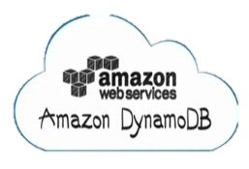



background
Current Application*
Dynamo DB to store the sensor reading data
PostgreSQL Relational database to store the data for data other than sensor readings
Rails application to serve the functionality of SDS
jqplot is applied as the visualization tool
*Team 4 Presentation – Architecture Design (2012)

Slide 5


background
Proposed Application
Dynamo DB to store the sensor reading data
In-memory database solution for accelerated analytics
PostgreSQL Relational database to store the data for data other than sensor readings
jqplot is applied as the visualization tool
Rails application to serve the functionality of SDS

Slide 6

background
Proposed Application
Dynamo DB to store the sensor reading data
In-memory database solution for accelerated analytics
PostgreSQL Relational database to store the data for data other than sensor readings
jqplot is applied as the visualization tool
No Native support for SAP HANA

Slide 7

background
Proposed Application
In-memory database solution for accelerated analytics
Java based application to expose RESTful APIs for sensor data
D3 applied as the visualization tool
Java based Web application utilizing RESTful APIs for data visualization
Sensor Data as a Service (REST)
Module
Module

Slide 8
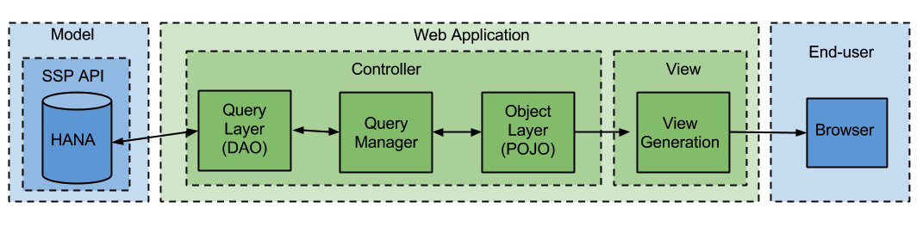
Architectural Overview
Design is highly modular
Design decouples presentation, business logic, and data access
Promotes extensibility and reuse of components

Slide 9
Framework Selection
Given that the end product is a web application, the first major task is to select a framework.
The major benefits of using a framework for development are:
Ease of development
Built-in support for the Model-View-Controller Pattern
Frameworks under consideration were:
Play
JRuby
Spring
Grails

Slide 10
Framework Selection
Criteria to evaluate frameworks
Heroku Compatibility
For ease of deployment
Language Extensibility
For potential changes in the future
Ease of Use
For speed of development
The ability to leverage existing work
For speed of development
Existing HANA API Framework
For potential close integration in the future
Satisfying the project requirements
For actually building what the customer wants

Slide 11
Framework Selection
Comparison of Frameworks
 | Play | JRuby | Spring | Grails
Heroku | Supported | Supported | Supported | Supported
HANA APIs | Written in Play | N/A | N/A | N/A
Language extensibility | Could shift to Scala | N/A | N/A | N/A
Ease of use | High ease of use | No teammember familiarity | High ease of use | No teammember familiarity
Leverage existing work | N/A | Potential to leverage existing Ruby work | N/A | N/A
Satisfies Project Requirements | Yes | No - project requires shift away from Ruby | Yes | More research needed

Slide 12
Framework Selection
Play Framework was selected
Had the edge in Ease of Use, Extensibility, and the fact that the HANA APIs are currently using Play
JRuby
Would have allowed leveraging of previous work, but didn’t fit project guidelines
Spring
Easy to use, but didn’t have as many advantages as Play
Grails
No team member familiarity
Since speed was an important factor, this impacted Grails

Slide 13
Governance
Documentation Guidelines
SenWeb documents all classes with class level and method level comments.
SenWeb is commented in order to generate documentation from the JDK “javadoc” tool.
Testing Guidelines
Use JUnit 4.11 for testing by annotating methods with @Test and classes with @RunWith(JUnit4.class).
SenWeb provides Unit and Integration test cases for all classes and logical modules.

Slide 14
Design Patterns
Model View Controller
The standard pattern for building web applications.
Pros
Separates presentation from the underlying data
Provides a high degree of maintainability for a codebase
Cons
Requires more effort to set up correctly
Analysis
Modern development frameworks provide most of this heavy lifting, so the benefits can be obtained at a lower cost.

Slide 15
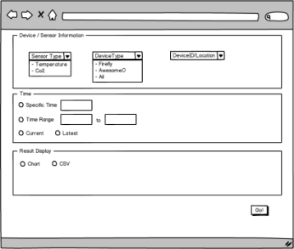
Design Patterns
UI Wizard
Presentation layer pattern
Pros
Minimizes errors and misunderstandings
Provides Clear Flow and prompt feedback throughout the process
Cons
Forces the user to follow steps as we define them
Analysis
Clarity and ease-of-use outweighs the restriction on users’ process

Slide 16
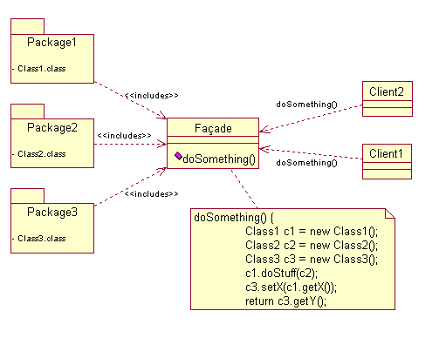
Design Patterns
Facade
Our Query code is a facade for the underlying API
The web app is a facade for users for the API
Pros
Clarity of implementation
Proper separation of concerns
Hiding of implementation details
Cons
Additional time spent in up-front design
Analysis
Makes code clean and effective

Slide 17
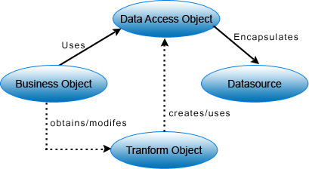
Design Patterns
Data Access Object
Separate the connection with an underlying data source from the rest of the business logic code
For SenWeb, the HANA API specific DAO is what is hiding behind our Query Facades.
Pros
Modularizes code
Proper separation of concerns
Cons
Requires more code to maintain
Analysis
Allows us to insulate higher-level classes from lower-level ones

Slide 18

Design Philosophy

Slide 19
MVC Pattern
View
Controller
Model (from JSON)

Slide 20
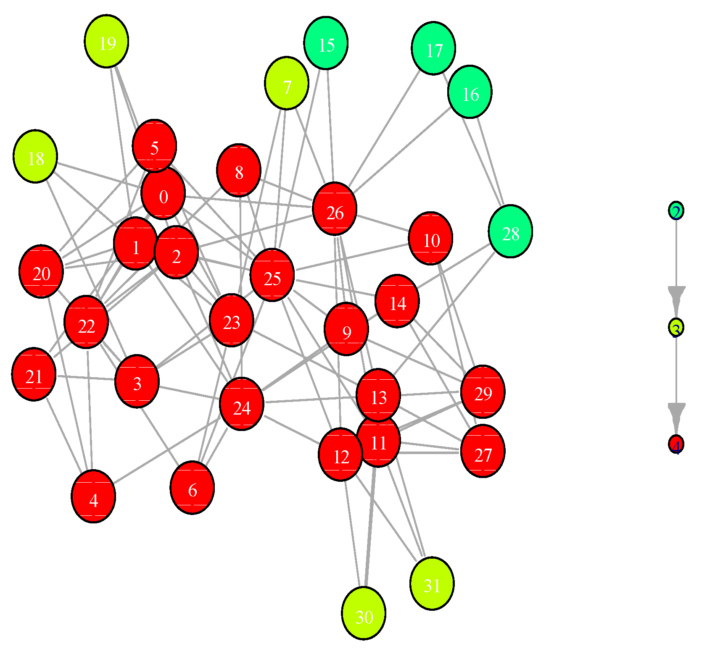
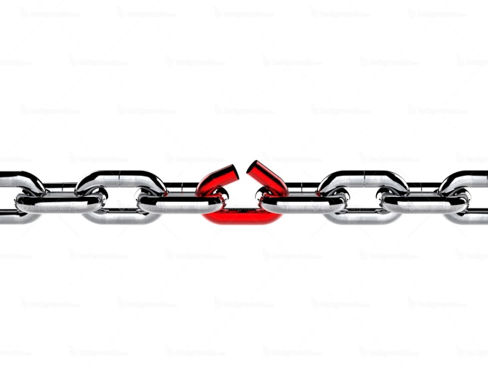
Low Coupling/Tight Cohesion

Slide 21



Maintainability/reusability/ EXtensibility

Slide 22

DemoNSTRATION

Slide 23
Recommendations
Continue to utilize patterns that modularize and separate concerns
Develop requirements for user login and implement appropriately
Continue to expand Sensor Service Platform API to cover all CRUD operations
Make Sensor Service Platform API discoverable
Give clients more flexibility in what they request from the API
e.g. clients may get standard set of fields or may specify certain ones

Slide 24
Future work
Add implementation for Category 4 APIs
Represents CRUD operations
Sensors
Devices
Device Agents
Sensor Types
Device Types
Implement User Login and access control.
Increase charting ability for Dashboard page.

Slide 25
conclusion
Design: Modular, Decoupled and componentized
Macro: Modular service oriented architecture with RESTful protocol
Micro: Design patterns selected based on context
Play Framework: Compatible and Java based.
Further expansion
Discoverable and configurable RESTful APIs
Support complete CRUD operation on sensor data
Role based access restrictions
Real-time visualization

Slide 26
Appendix: Repository Location
https://github.com/robwblack/mercury

